Slide 1

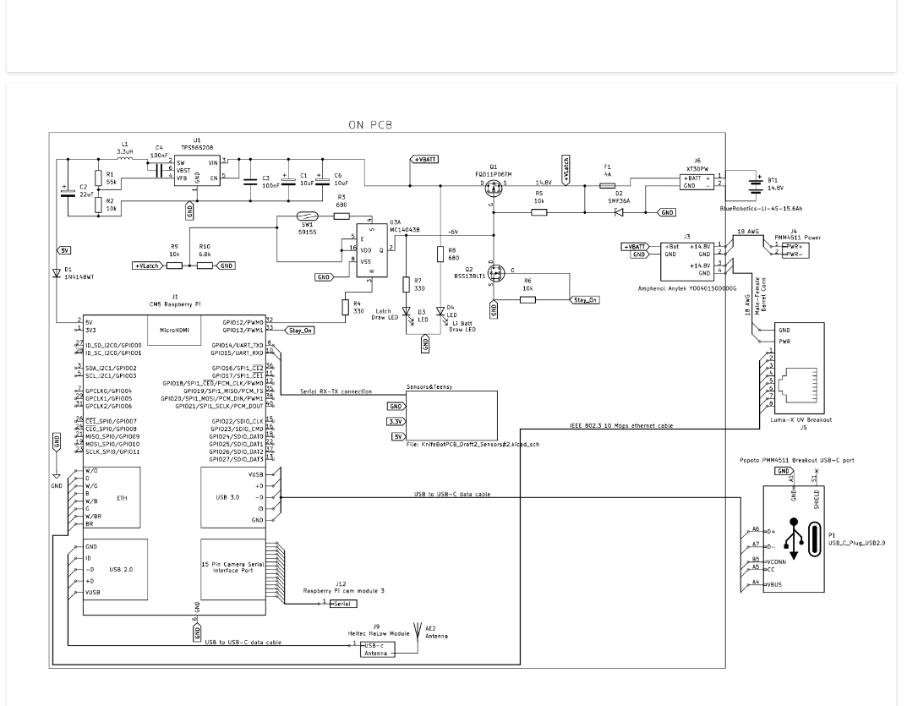
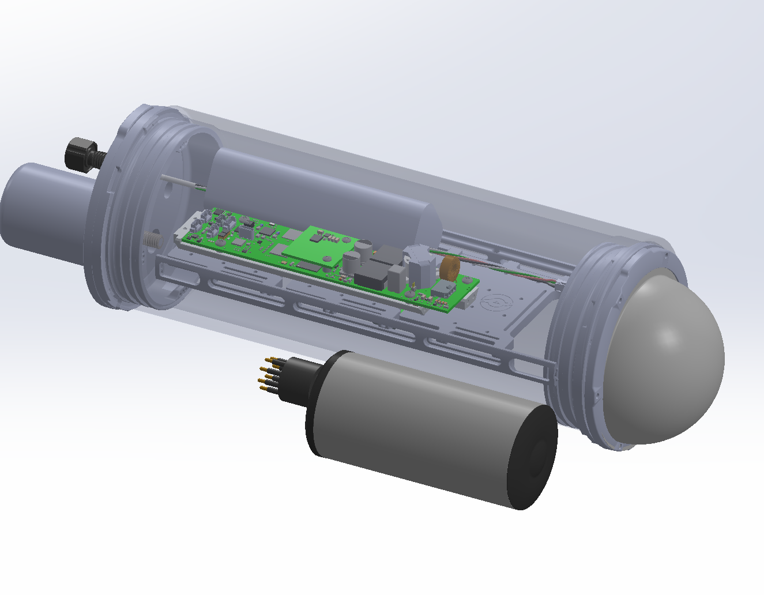
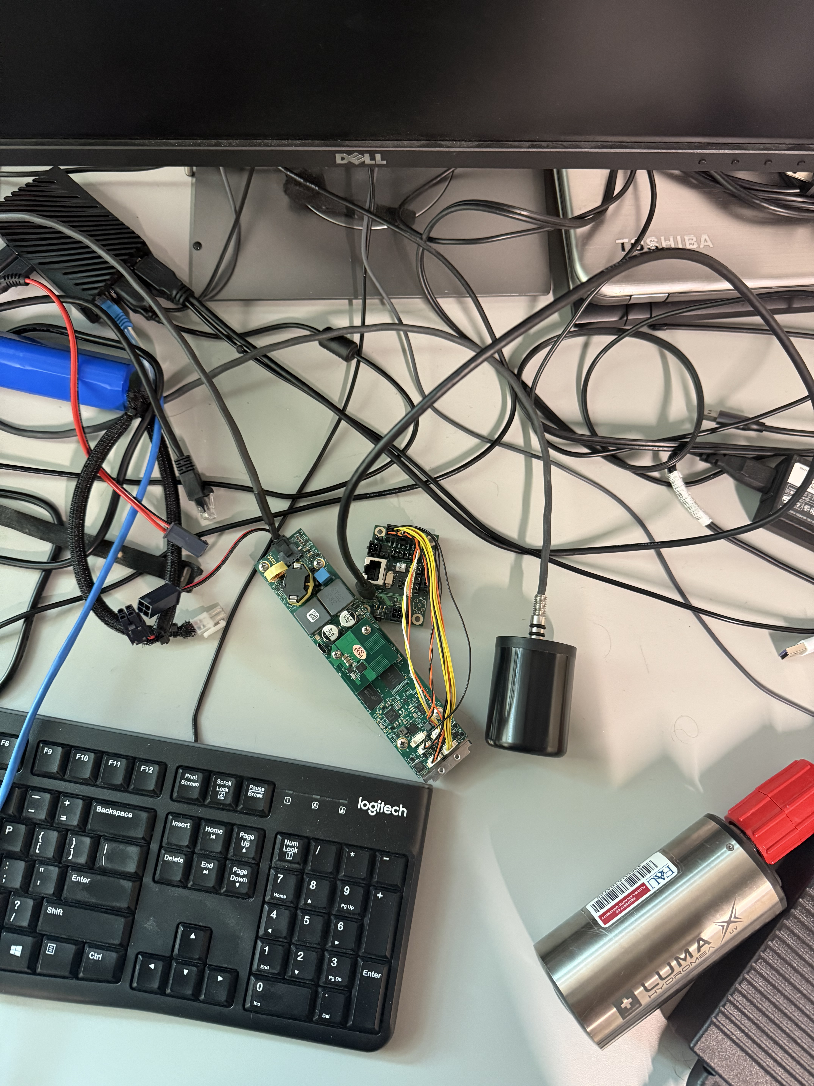
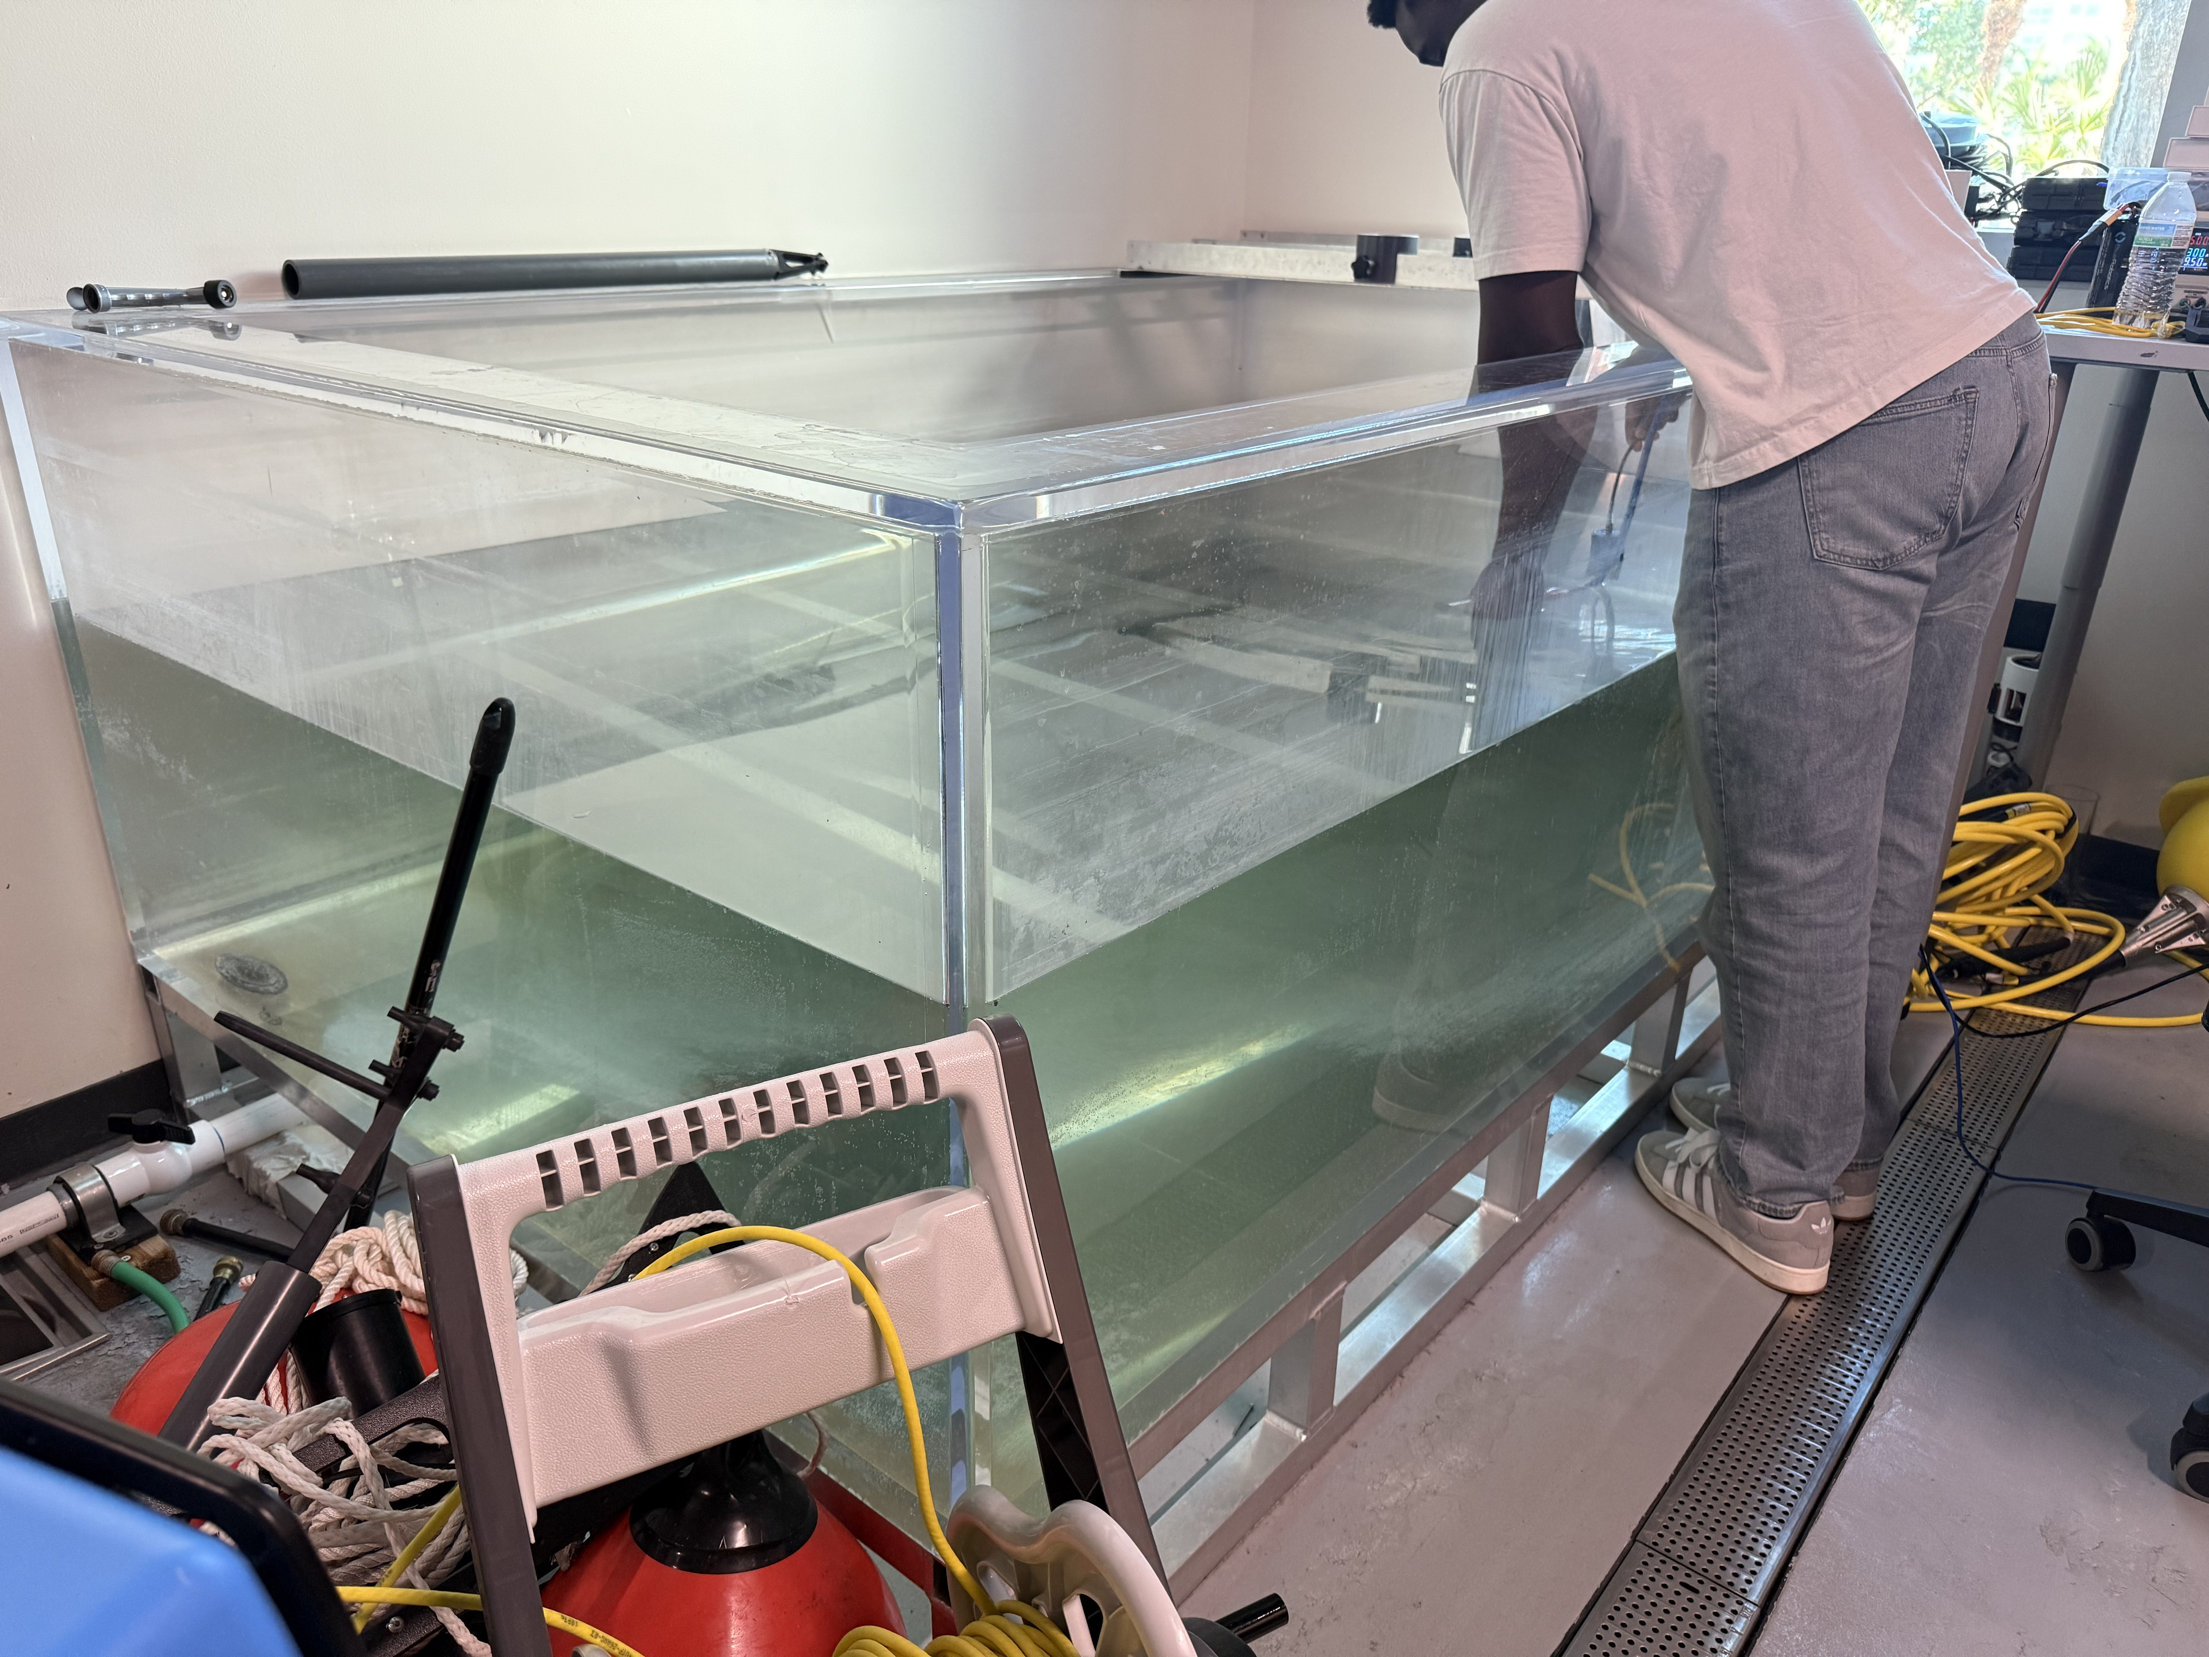
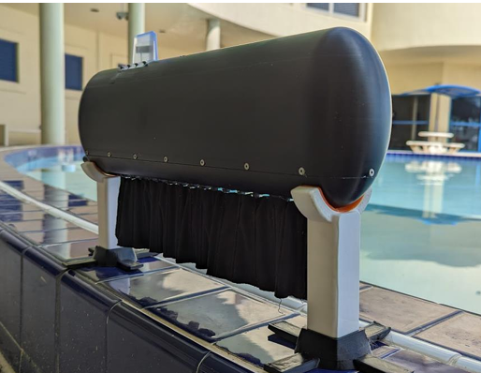
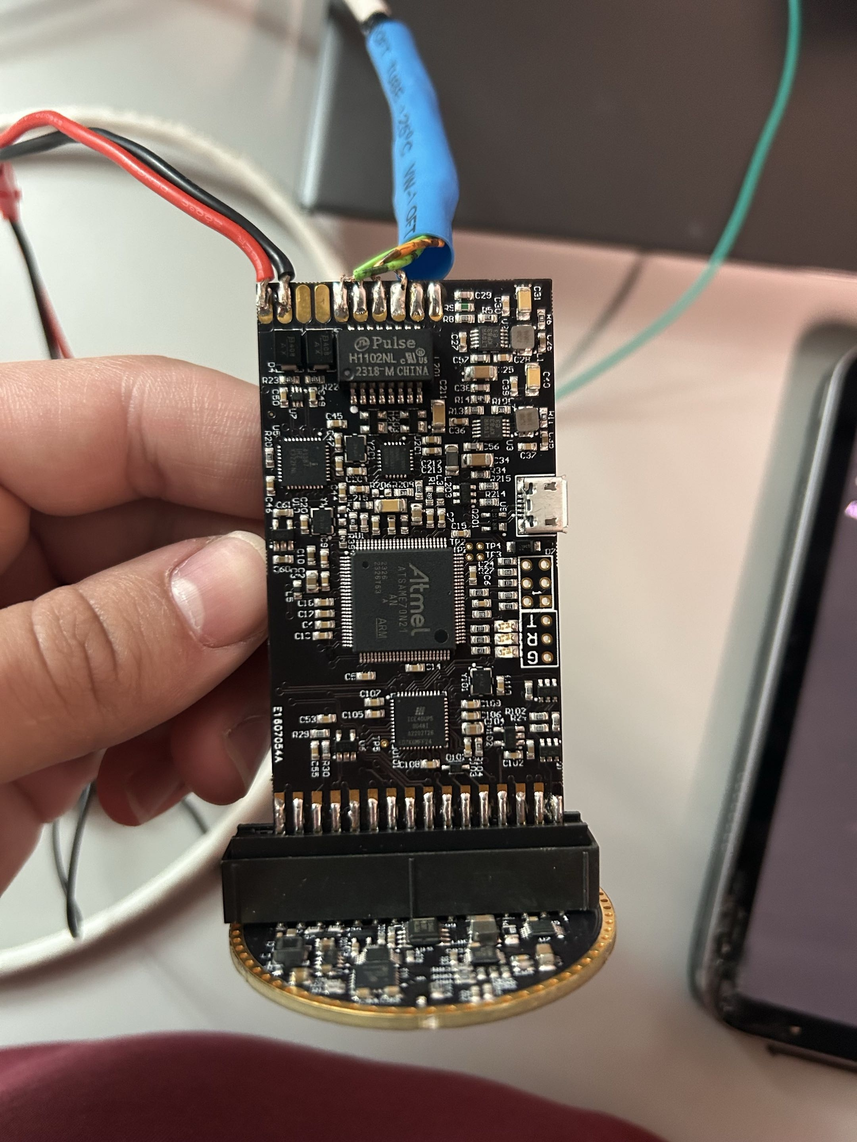
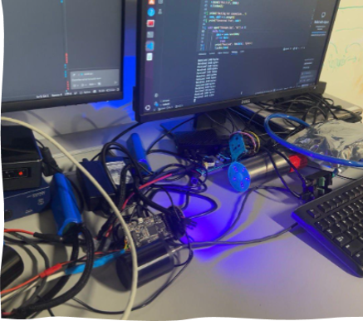
Underwater Multimodal Modem for KnifeBot
Team Members
Faculty Course Facilitator
Jeremy Thyn David Osemene Nicholas Alberto
Mario Rodriguez
Laiba Baig
Professor Yang
Professor Ni
EGN 4952C
Electrical Engineering & Computer Science
Project Advisor
#12
Sponsored by: Dr. Georgios Sklivanitis,
Center for Connected Autonomy and AI
Waseem Asghar
Problem Statement
Ocean researchers, offshore industry, and government naval operations all require communication networks that can send data across the ocean under the water. However, this can be a challenge especially with higher frequency communications (High attenuation in sea water at 100 kHz+). Our communication network takes advantage of underwater acoustic (UW-A) and underwater optical (UW-O) modems to maximize data throughput by switching which modem is active based on the data being transmitted and the conditions of the water.
Results
Fig 1: Part of wiring diagram of the PCB, RPi 5 Compute module, Teensy 4.1, and UW modems
Serial sensor data transmission through UW-A up to 10 kbps and video streaming with the UW-O at 2 Mbps for 480p 30 fps and, in ideal conditions, ~20dB SNR.
Estimated battery life of around 8 hours of active transmission with a 266Wh battery with battery drainage protection on PCB.
Each set of units fit in a custom waterproof container (11.8" x 4" x 5" & 11.8" x 8" x 9") including modems, PCB, battery, sensors, RPi 5 compute & breakout, and Teensy 4.1.
Fig 2: 3D model of the entire unit including a battery, UW-O unit, PCB, and UW-A transducer within the waterproof container
Fig 4: KnifeBot drone prototype
Fig 5: Acoustic modem and transducer connected to Pi for testing
Conclusions & Impact
Difficulties including dealing with different communication protocols along with testing the modems in different conditions and creating the electrical and mechanical components were the bulk of the work. Overall, between the technical and time management difficulties faced we have learned a lot and have a deeper understanding of what it means to work within an engineering team.
This system can be applied to ocean reef research (this project is designed specifically for integration with another project, the KnifeBot). Otherwise, this technology can be used with military autonomous drones, live monitoring of underwater cables, or even deep-sea research missions with autonomous drones.
Fig 3: David Osemene testing the functionality of the optical modem in the lab tank
Fig 6: Comms test of optical modems out of water through our program
Fig 7: Bare UW-O unit with soldered on ethernet and power cables

